Slide 1
The Second Empire of France
The Unification of Italy
The Unification of Germany
Priya Arulmani

Slide 2
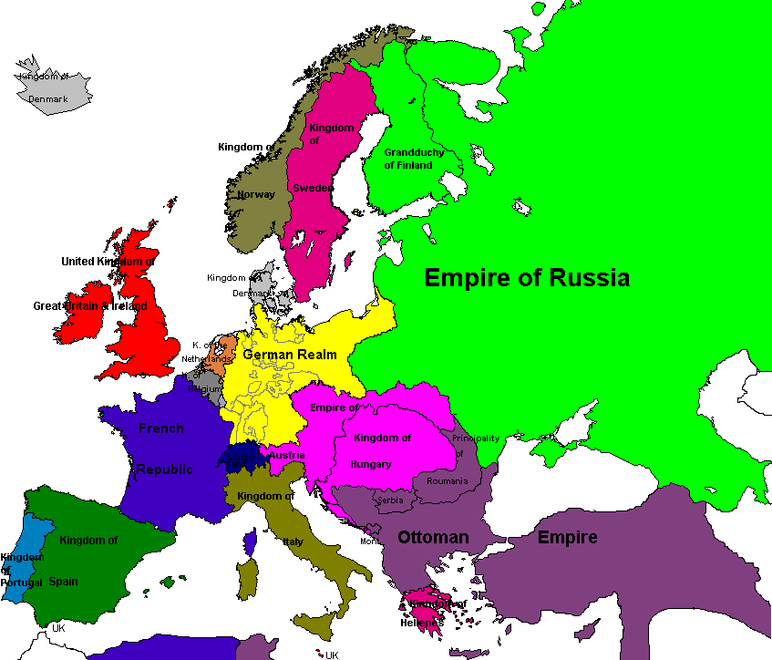
Click on the topic you want to see!
Unification of Germany
France’s Second Empire
Unification of Italy

Slide 3
The Second Empire of France
Feb. 23: Abdication of Louis-Philippe; formation of the Second Republic
Dec. 20: Louis Napoleon elected president of the Second French Republic
March 27: France and Britain declare war on Russia leading to the Crimean War
Jan. : Expedition to Mexico sent
1848
1870
1851
1852
1854
1859
1860
1856
1862
Feb.–April: Congress of Paris
Dec. 2: Louis Napoleon’s coup d’etat
Dec. 2: The Second Republic named the Second Empire; Louis Napoleon crowned Emperor Napoleon III
April 8: France and Britain declare war on China
Franco-Prussian War; ends with French defeat and the fall of the Second Empire
May 3: Declared war on Austria

Slide 4
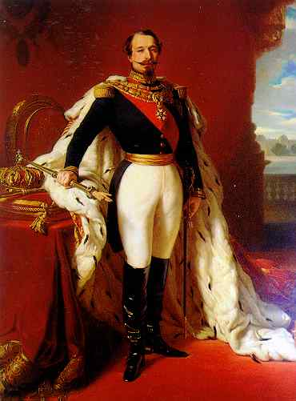
Louis Napoleon
Nephew of Napoleon I
Elected president of France’s second republic after abdication of Louis Philippe
1851: tried to get the Chamber of Deputies to pass a law that allowed for a second presidential term
Law was rejected
December 2, 1851: Coup d’etat
Paris put in state of siege
200 Deputies arrested
Troops in Paris streets
Much resistance across France
hundreds killed, 20,000 arrested
Louis Napoleon decreed presidency is 10 years
Also reinstated universal male suffrage
Almost unanimous reelection of Louis Napoleon
December 2, 1852: crowned Napoleon III, Emperor of France
Emperor Napoleon III by Franz Xaver Winterhalter

Slide 5
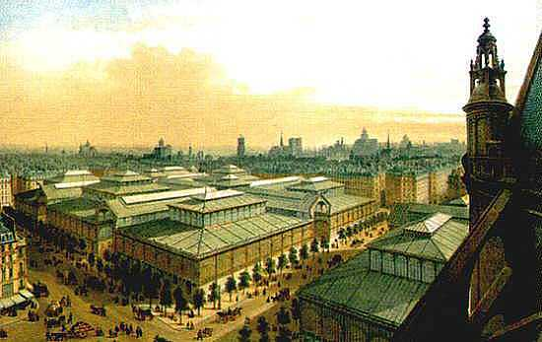
The Empire Under Napoleon III
Rebuilding of Paris by Georges Haussmann
Authoritarian government
Paid much attention to public opinion and used propaganda
Supported by businessmen, Catholic church, most monarchists, local notables, peasants
Sponsored programs for economic growth and social welfare
Supported inventors and technological advancement
Used tax incentives to stimulate investment
Rebuilding of Paris by Haussmann
Liberalism in the Empire
Commercial treaty with Britain to allow free trade
Enlarged role of legislature
By 1870 – full parlimentary system
Granted freedom of press and assembly and right to strike
Supported Workers Organizations

Slide 6
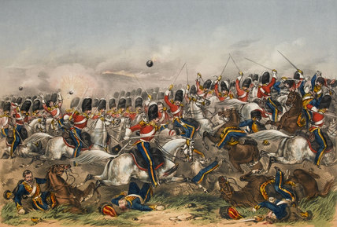
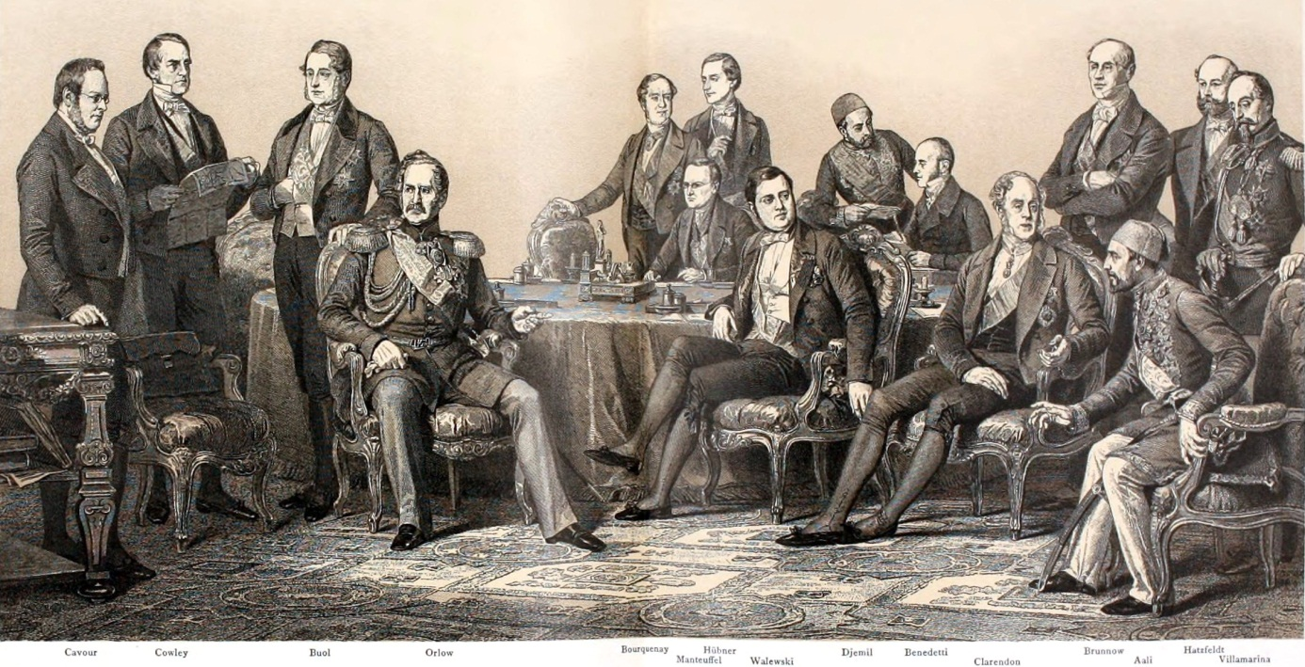
The Crimean War and the Congress of Paris
1854-1856
France and Britain allied against Russia over power struggle in Middle East
Fought more for prestige
Battle fought in present day Crimea because it was most convenient battleground
Had support and troops from Piedmont against Russia
After a year of fighting, Austria threatens to join France and Britain
Russia sues for peace and they meet in the Congress of Paris
France, Britain, Russia, and Ottoman empire sign Treaty of Paris
Treaty of Paris:
Black Sea is neutral territory
Danubian territories (Moldavia and Walachia, called Romania after 1859) given as semi-independent territories to Ottoman empire
Christians in Ottoman empire given better status
Ottoman empire boundary returned to as it was before the war (loss to Russia)
Back to Map

Slide 7
The Unification of Italy
Expedition of the Thousand
Aug. – Sept.: Garibaldi becomes Dictator of Naples
Sept. 18: Garibaldi and Emmanuel unite north and south Italy
1849
1850
1852
1859
1860
1861
1854
Feb. : Formation of the Roman Republic
April 29: Austria declared war on Piedmont; Napoleon joins Piedmont against Austria
Cavour made Prime Minister of Piedmont
July 3: Roman Republic defeated by French
March: Mazzini arrives in Rome and is elected head of triumvirate; Victor Emmanuel II crowned King of Piedmont
April 12: Pope returned to Rome
July: Cavour resigns out of shame of Austria’s victory
March: Victor Emmanuel II crowned King of Italy
Piedmont sends troops to aid of French in Crimean War
Jan.: Cavour returns as Prime Minister

Slide 8
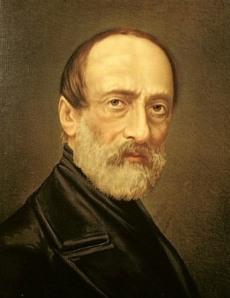
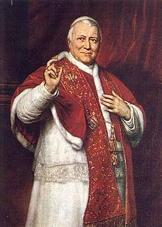
The Roman Republic and Mazzini
Guiseppe Mazzini
The republic lasted from Feb. – July 1849
The pope was driven out of Rome during the revolts of 1848 and Rome became a republic
They called in Guiseppe Mazzini and he became an honorary Roman citizen and the head of the triumvirate
Mazzini wrote letters to Pope Pius IX to unify Italy, but was ignored
The pope asked other Catholic countries for help and the republic was crushed by the French
Mazzini returned to England and formed the Friends of Italy which supported unification
He sent Orsini to France to assassinate Napoleon III but that plot failed
After Austria regained control, Mazzini returned to exile
Pope Pius IX

Slide 9
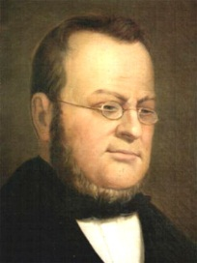
Cavour and Piedmont
Camillo Cavour
Cavour became prime minister of Piedmont in 1852
Reasons for Piedmont’s strength:
Military strength
Conservative philosophy
Stable government with a parliamentary system and King Victor Emmanuel II
Cavour added to this by:
Implementing free trade
Managing Piedmont’s finances
Building railroads
Piedmont began to take a bigger role in trade to draw trade away from Austria
Cavour encouraged people to participate in government and shaped public opinion against Austria and in favor of unification using propaganda
His goal was to make Piedmont the center of the Italian resorgimento (resurgence)

Slide 10
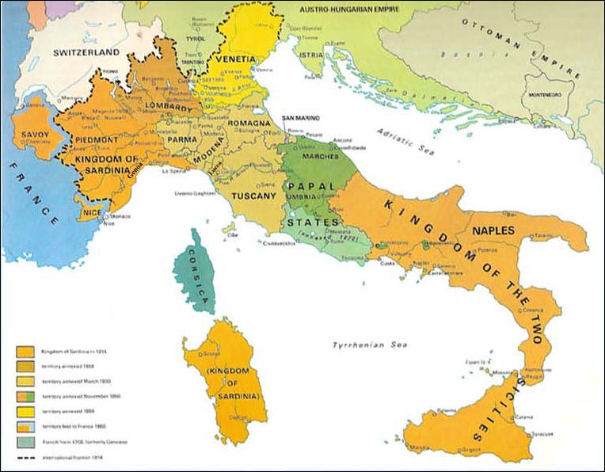
Cavour and Piedmont
Lombardy
Cavour met with Napoleon III to secure alliances with a strong European power against Austria
France got Nice and Savoy in return for allying with Piedmont
Austria had control of Lombardy and Venetia, but Lombards and Venetians fled to Piedmont
1859: Austria declares war on Piedmont and France joined Piedmont against Austria soon after
Piedmont received Lombardy after the war, but all other Italian states remained the same
Napoleon III did not approve of a unified Italy, so it agreed with Austria and did not give Piedmont Venetia as well
Cavour resigned as prime minister out of shame of Piedmont’s loss
He returned the following year
Venetia
Piedmont

Slide 11
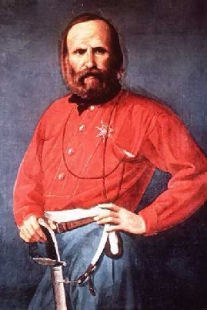
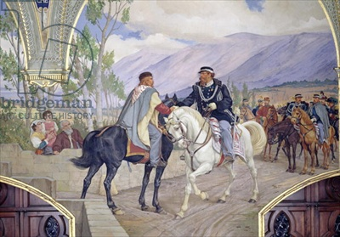
The Expedition of a Thousand and Guiseppe Garibaldi
After being exiled for revolutionary activities, Giuseppe Garibaldi went to South America to fight for democratic causes
1848: He returned to Italy and took part in the revolt, the Roman Republic and the Expedition of a Thousand
1859: gathered volunteer soldiers from Genoa, Lombardy, Venetia, and Romagna and set sail for Sicily
The Kingdom of Two Sicilies was occupied in two months and Garibaldi headed to mainland Italy
He made to attack Rome, but Cavour started riots in the Papal States to draw Garibaldi away from Rome and prevent France and Austria invading and ruining the unification plan
1860: two thirds of the Papal States joined Piedmont
The Piedmont army went south to meet up with Garibaldi where he shook King Victor Emmanuel’s hand and unified North and South Italy
Only states remaining were Rome and Venetia
Guiseppe Garibaldi
Teano Handshake marking the Unification of Italy

Slide 12
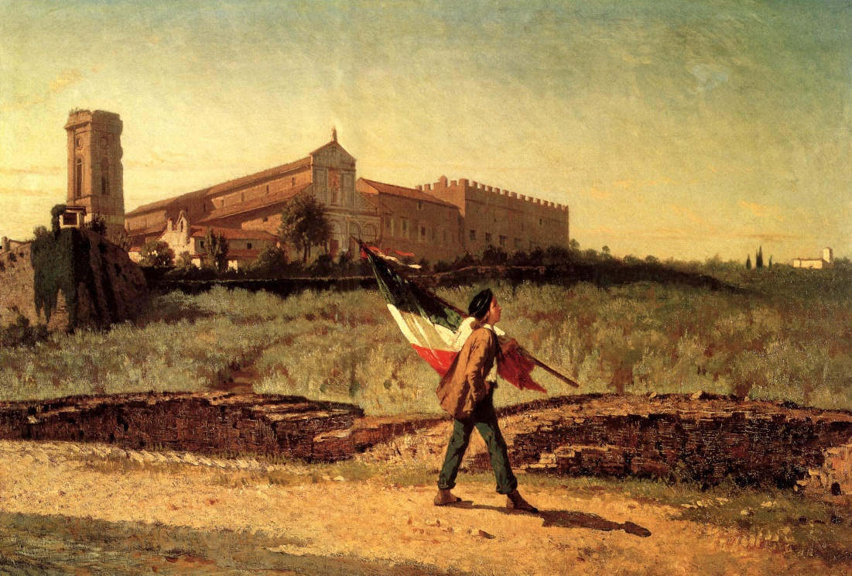
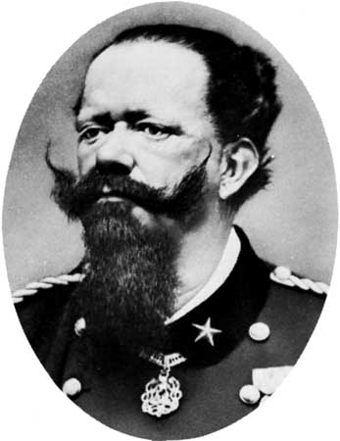
Annexation of Venetia and Rome
Napoleon III protected Rome because Catholics were against annexation
Austrian troops occupied Venetia
1866: Italy got Venetia during the Austro-Prussian War for supporting the Prussians against Austria
1870: Rome was annexed during the Franco-Prussian War when French troops withdrew
Rome was made the capital of the Kingodm of Italy with King Victor Emmanuel II
Risorgimento
King Victor Emmanuel II
Back to Map

Slide 13
The Unification of Germany
Jan: German Empire declared at Versailles; William I crowned German Kaiser
1849
1851
1858
1862
1864
1865
1866
1867
1870
1871
Otto von Bismark named chief minister to William I
June: Prussians march on Holstein and start Austro-Prussian War
Aug: War ends at Peace of Prague
July: Bismark forms North German Confederation
May: German Confederation reestablished
March: Frankfurt Parliament created a constitution for entire Confederation
Crowning of William I as King of Prussia
Aug: Convention of Gastein – Austria gets Holstein; Prussia gets Schleswig
Jan: Austria and Prussia declare war on Denmark
July: Denmark surrenders
July: France declares war on Prussia starting Franco-Prussian War
Oct: French army surrenders and Second Empire falls
Nov: South German states, except Austria, join confederacy

Slide 14
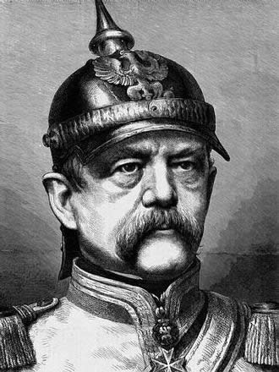
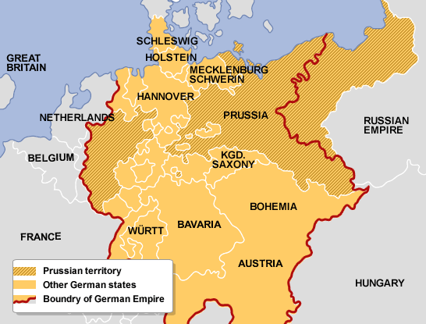
Why is Prussia so strong?
Prussia
Zollverein – tariff union prospered
Industrialization
Austria’s international problems made Austria weaker
Largest German state
Had the strongest army
Efficient administration
1850: allowed universal male suffrage but had three classes with unequal representation to prevent democracy
1858: King William I crowned King of Prussia
Increased industrial wealth went to doubling the army against legislature
Liberals gained in elections of 1862, so William I made Otto von Bismark chief minister
Otto von Bismark

Slide 15
Bismark and Denmark
Member of Junker class
Determined to unite the German states with Prussia at the lead
Believed in military strength rather than liberal reforms
Ignored parliament and encouraged division in legislature
1864: King of Denmark tried to annex Schleswig and Holstein
infuriated nationalists in Germany
Prussia and Austria went to war against Denmark
Austria gained control of Schleswig
Prussia gained control of Holstein

Slide 16
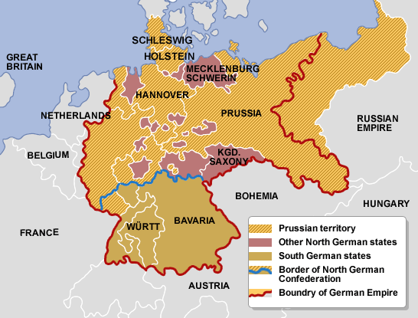
The Austro-Prussian War
Prussia allied with France, Italy, and Russia to keep Austria isolated
June 1866 – Prussia invaded Holstein
War lasted seven weeks and ended with Prussian victory
Did not gain any Austrian land but gained German states loyal to Austria
Established North German Confederacy and made military alliance with southern states

Slide 17
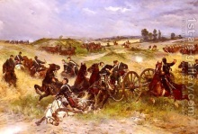
Franco-Prussian War
Franco-Prussian War
1870
Fought over replacement of Queen Isabella II as ruler of Spain
France declared war on Prussia
France expected support from Italy and Austria but they remained neutral
French defeated at Sedan and Napoleon III taken prisoner
January 1871: French army surrendered in after Paris captured
End of the Second Empire

Slide 18
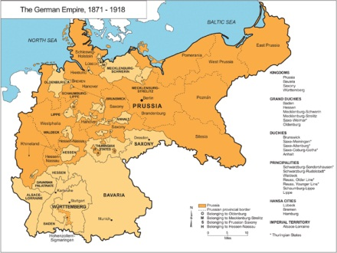
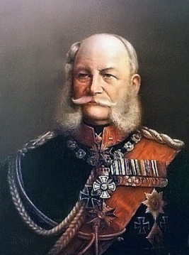
The Second Reich
South German states helped fight French but needed negotiations with Bismark to join German Confederacy
German Confederacy becomes German Empire
January 18, 1871: King William I crowned first German Kaiser (emperor) at Versailles
King William I
Back to Map

Slide 19
Works Cited
Alford, Ben. "Unification of Germany Timeline." Unification of Germany Timeline. Student Notes, 12 Nov. 2011. Web. 27 Jan. 2013.
BBC News. BBC, n.d. Web. 25 Jan. 2013.
Bresler, Fenton S. Napoleon III: A Life. 1st ed. New York: Carroll & Graf, 1999. Print.
"Charge of the Heavy Brigade, Balaklava, 1854." National Army Museum Prints. N.p., n.d. Web. 27 Jan. 2013.
Chastain, James. "Roman Republic." Roman Republic. N.p., 2004. Web. 25 Jan. 2013.
"Crimean War." Encyclopedia Britannica Online. Encyclopedia Britannica, n.d. Web. 27 Jan. 2013.
Durghali, Matthew. "Silvapages." Louis Napoleon's Coup D'Etat. N.p., n.d. Web. 26 Jan. 2013.
"France Timeline." BBC News. BBC, 06 May 2012. Web. 25 Jan. 2013.
"Giuseppe Mazzini (Italian Revolutionary) : Stay in England." Encyclopedia Britannica Online. Encyclopedia Britannica, n.d. Web. 27 Jan. 2013.
Graig, Gordon Alenxander. Germany: 1866-1945. Oxford: Oxford UP, 1980. Print.
"The History of the World; a Survey of a Man's Record." The History of the World; a Survey of a Man's Record. N.p., n.d. Web. 26 Jan. 2013.
ImagineEasy Solutions, LLC. "The Free Automatic Bibliography and Citation Maker." EasyBib. ImagineEasy Solutions, LLC, 2001. Web. 27 Jan. 2013. <http://easybib.com/>.
"Italian Unification-Timeline." Purbeck School Humanities. N.p., 15 Nov. 2010. Web. 26 Jan. 2013.
"Italy." Italy. N.p., 2012. Web. 25 Jan. 2013.
Mancuso, Janice. "Camillo Benso Di Cavour." Italian Historical. N.p., n.d. Web. 26 Jan. 2013.
"Napoleon III Biography." Bio.com. A&E Networks Television, 2012. Web. 25 Jan. 2013.
"Napoleon III Biography." Dromo's Den. N.p., n.d. Web. 27 Jan. 2013.
"Napoleon III (emperor of France) : Foreign Policy as Emperor." Encyclopedia Britannica Online. Encyclopedia Britannica, n.d. Web. 26 Jan. 2013.
"Napoleon III (emperor of France) : Presidency." Encyclopedia Britannica Online. Encyclopedia Britannica, n.d. Web. 28 Jan. 2013.
"Napoleon III." Infoplease. Infoplease, 2005. Web. 28 Jan. 2013.
"Paris, Congress Of." Infoplease. Infoplease, 2005. Web. 27 Jan. 2013.
Thomson, David. France: Empire and Republic. New York: Harper & Row, 1968. Print.
"Timelines." Life and Reign of Napoleon III. The Napoleon Foundation, 2008. Web. 26 Jan. 2013.
"Unification of Italy." ThinkQuest. Oracle Foundation, n.d. Web. 26 Jan. 2013.
Watson, Peter. The German Genius. New York: HarperCollins, 2010. Print.
Williams, Roger L. Modern Europe: 1660-1945. N.p.: St. Martin's, 1964. Print.

